Slide 1

Big Store Company Budget Plan
Sumaiya Shrabony

Slide 2

Agenda
Introduction
Historical Revenue By Region
Historical Revenue by Subcategories
Total Revenue Forecast
Revenue Forecast by Region
Revenue Forecast by Subcategories
Strategy
New Product Recommendation
Risk and Challenges

Slide 3

Introduction
We at BSC have analyzed the revenue of 2017-2019 across our company based on region, category and subcategory. The purpose of the analysis is to create a 3-year budget plan for the company to focus on key/critical products and adopt appropriate marketing strategy to gain the highest revenue return from the targeted regions.
In the process, we have scrutinized the possibility of additional revenue growth of 5%, 10% and 15%. We have produced the 5% additional rational maximum growth for the year 1 budget and focused on mitigating and have leeway of change based on unexpected market landscape changes.

Slide 4
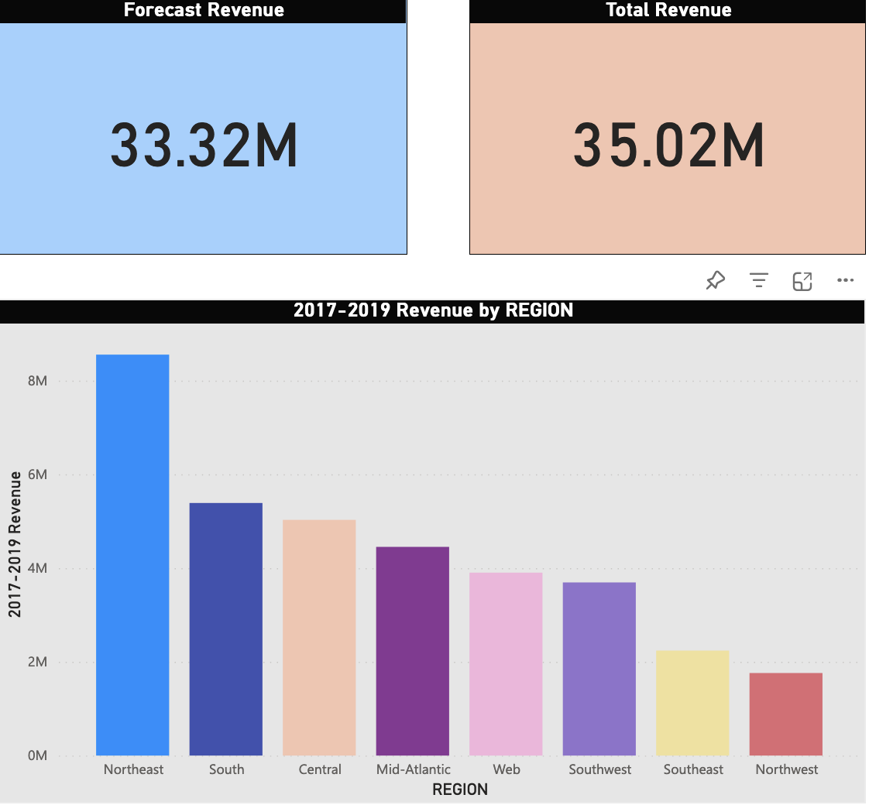
BSC Total Revenue By Region (2017-2019)
Northeast: 8.55M
South: 5.39M
Central: 5.03M
Mid-Atlantic: 4.45M
Web: 3.90M
Southwest: 3.69M
Southeast: 2.24M
Northwest: 1.76M

Slide 5
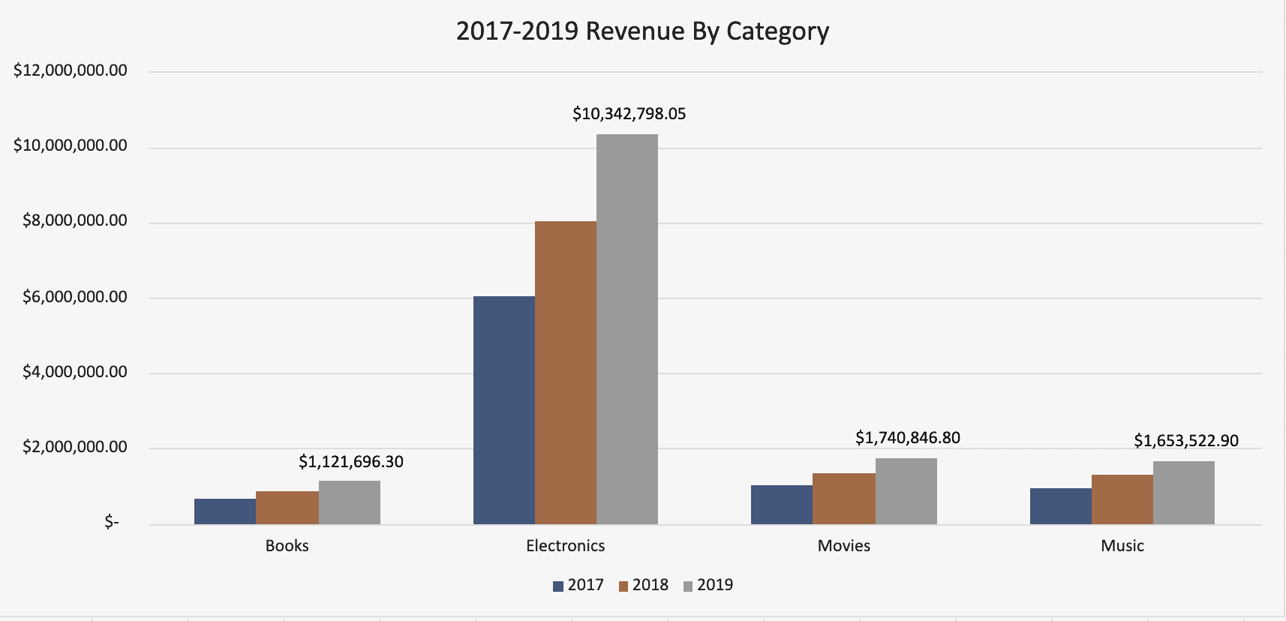
BSC Total Revenue By Category (2017-2019)
Electronics: 24.4M Movies: 4.09M
Music: 3.9M Books: 2.64M

Slide 6
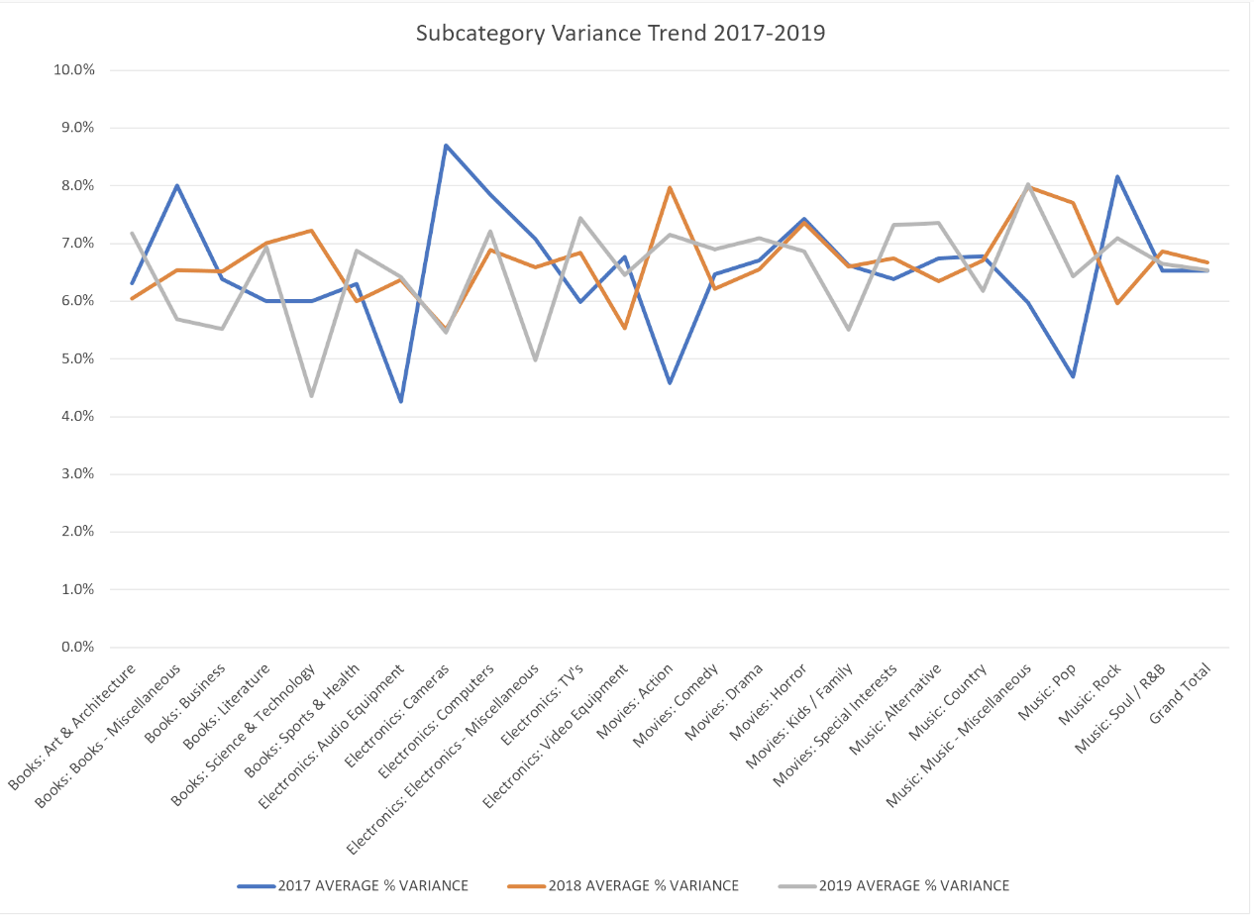
BSC Subcategory Variance Trend (2017-2019)

Slide 7
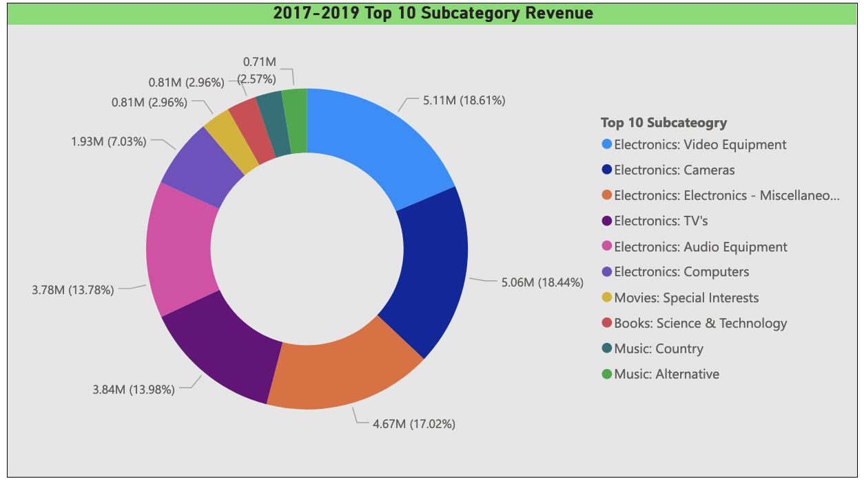
BSC Top 10 Subcategory Revenue (2017-2019)

Slide 8
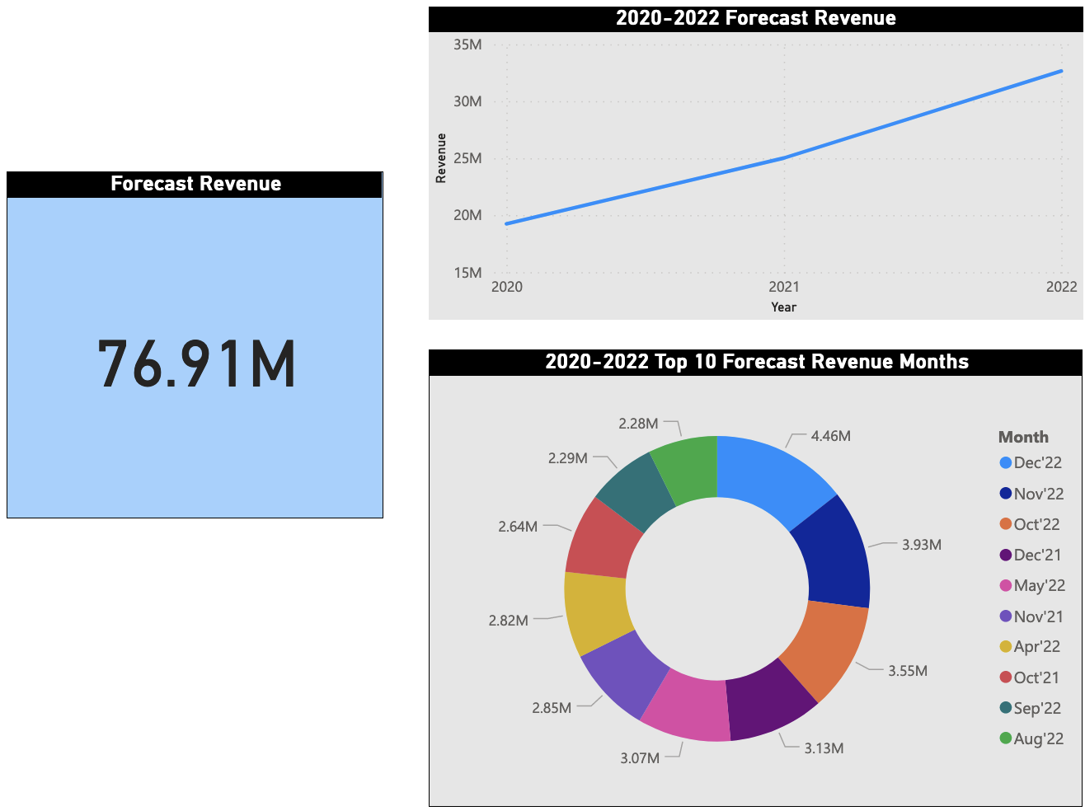
BSC Total Revenue Budget Forecast (2020-2022)
2020: 19.24M
2021: 25.02M
2020: 32.65M

Slide 9
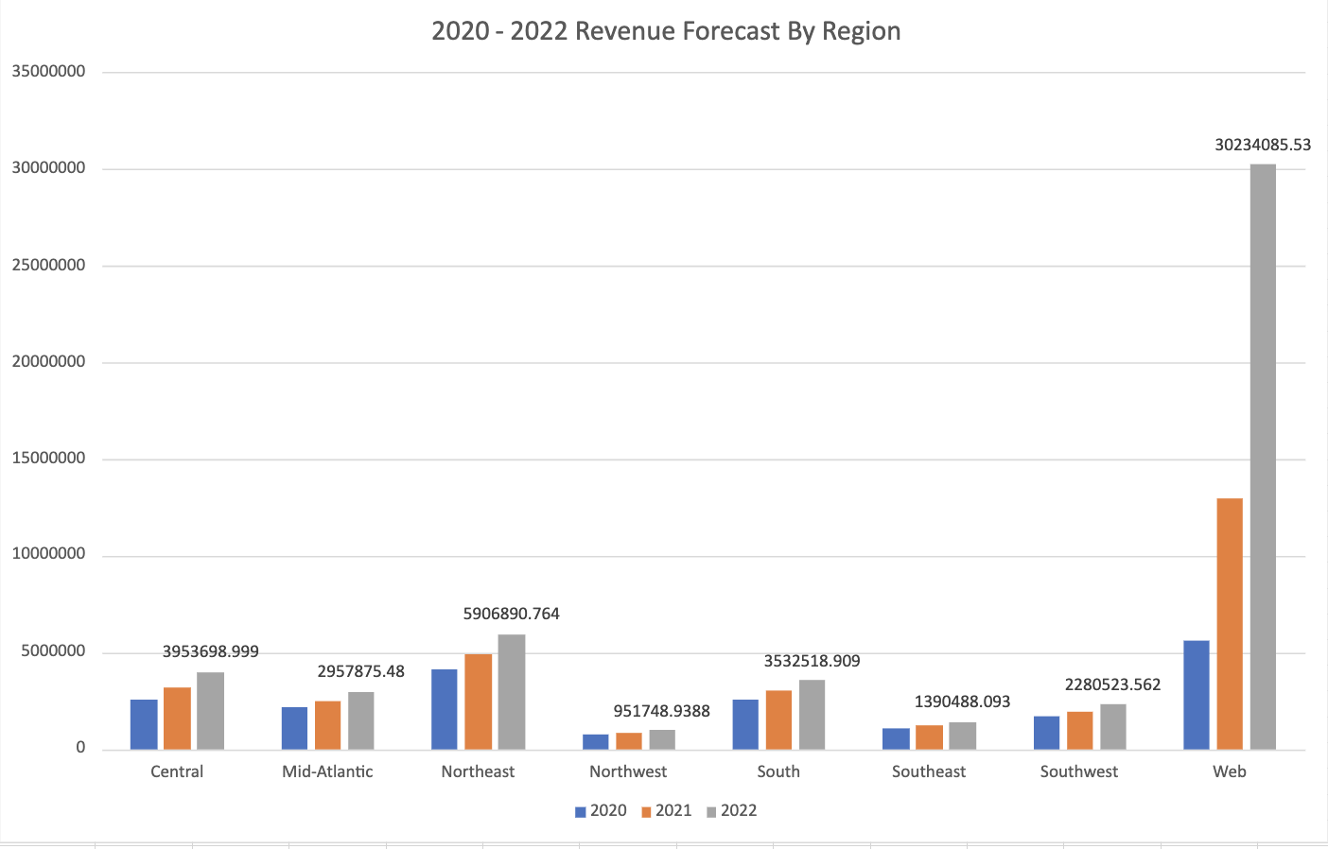
BSC Total Revenue Budget Forecast by Region (2020-2021)
Web: 48.8M
Northeast: 14.95M
Central: 9.7M
South: 9.06M
Mid-Atlantic: 7.58M
Southwest: 5.9M
Southeast: 3.6M
Northwest: 2.56M

Slide 10
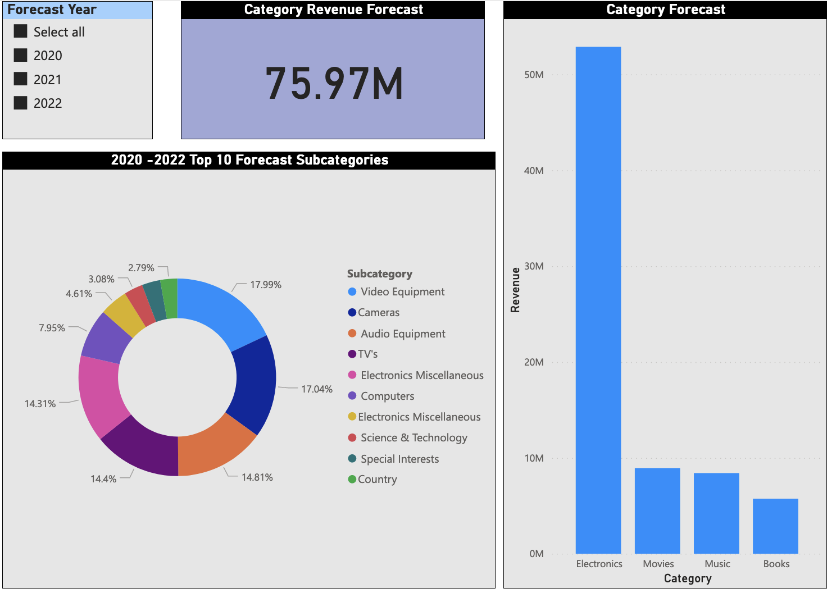
BSC Total Revenue Budget Forecast by Category and Subcategory (2020-2022)
Electronics: 52.88M​ Movies: 8.94M​
Music: 8.42M​ Books: 5.74M

Slide 11
Plan for Revenue Growth Scenario of Base+5%, Base+10%, and Base+15%
Rational Maximum Growth Rate: Target an additional 5% for the year 1 budget based on BSC's operational capabilities, financial resources, and market conditions.
Key Product Selection: Focus on key/critical product on each category and allocate resources towards promoting these products and expanding their market reach.
Electronics: Video Equipment, TV’s, Audio Equipment and Cameras.
Movies: Special Interest.
Books: Science & Technology
Music: Country.
Product Growth Targets: To increase sales rate up to 5% more than the revenue forecasted for 2020, recommend developing targeted marketing campaigns and promotional strategies to stimulate demand and drive sales.
Sales Channel: Focus extensively on Web sales by creating an e-commerce campaign and innovative digital presence to ensure forecasted revenue growth from the Web sales channel. We also need to focus on the Northeast region for our physical sales channel to utilize our existing supply chain and sales infrastructure.

Slide 12

New Product Recommendation
Smart Home Devices: With the increasing adoption of IoT technologies, smart home devices offer significant growth potential. These products encompass smart speakers, security cameras, and connected appliances, catering to consumers' desire for convenience and connectivity.
Movies from Book Adoption: Bringing in movies based on the popular book already on our sales channel can help us garner and produce a new customer base along with increasing the stickiness index. This can capitalize on the trend of offering a curated selection of quality products and give our company greater brand recognition.

Slide 13
Risks and Challenges
In the competitive market landscape of today’s world, macroeconomic indicators are always changing. While creating this budget plan, we are unaware of how the consumer mentality and market dynamics will change with the end of this pandemic.
In this scenario, we need to be flexible about pricing adaptation, inventory management, and promotional strategies accordingly to remain competitive and mitigate risks associated with market changes.
As we know the necessity to Introduce innovative products tailored to meet evolving consumer needs and preferences, we also need to keep in mind the possibility of increased actual cost and thus need to prepare ourselves to change the analytics models accordingly.

Slide 14

Conclusion
In navigating the complexities of the retail landscape, BSC must remain agile, innovative, and customer centric. By leveraging data-driven insights, embracing emerging trends, and mitigating risks effectively, we can position BSC for sustained revenue growth and long-term success in the competitive retail market.
After careful analysis, we have found out that our best strategy should be to focus on expanding heavily on the Electronics category followed by Movies and Music. It is also recommended to expand the market cap on Web and E-commerce and focus on Northeast region for physical expansion.

Slide 15

Thank you

